Slide 1
My Intoduction
Hi
My name is Sin Yuh Heng.

Slide 2
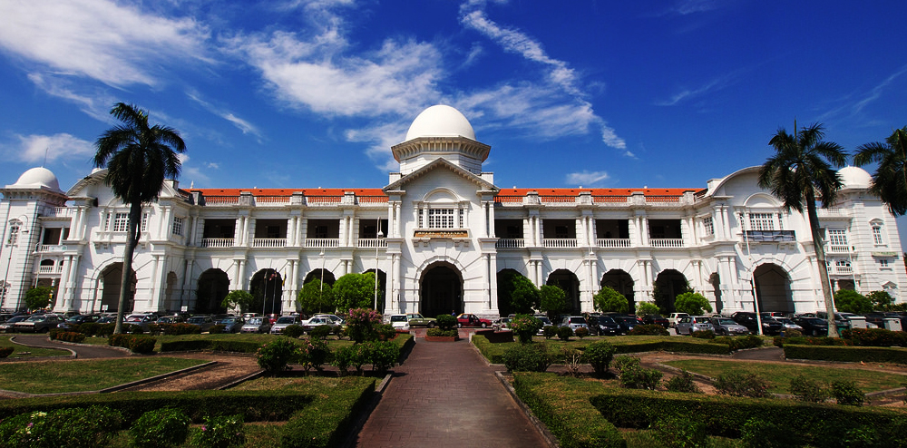
From: Ipoh, Perak, Malaysia
Born in: 06 September 2000

Slide 3
Hobbies: Playing Computer Games
Badminton
Dreams: Become an IT Company CEO

Slide 4
Thank You! Bye Bye

